Slide 1
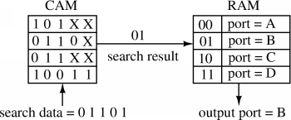
Novel Architecture, Integration, and Application of Content-Addressable Memories (CAM) for Parallel Search Engines, Networking, and SoCs
@ Embedded System iKohza
Content-addressable memories (CAMs) are specialized H/W search engines much faster than algorithmic approaches. CAMs are composed of conventional semiconductor memory (usually SRAM) with added comparison circuitry that enable a search operation. The most common search-intensive tasks that use CAMs are packet forwarding and packet classification in Internet routers.
As the data traffic on internet increases day by day along with the transit from IPv4 to IPv6, Internet routers are required to handle larger data with much higher speed.
This theme is to investigate the possibilities of novel architecture and integration (3D stacked is a candidate) to improve speed, power consumption and usability of CAMs. Application of CAMS to new frontier is another aim of this theme.
Example of Application:
Routing Table
NOR-type CAM
SL1c
SL1
Standard
SRAM Cell
BL1
BL1c
Example of CAM Cell Architecture

Slide 2
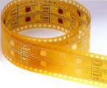
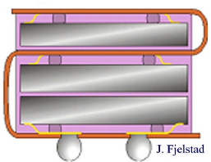
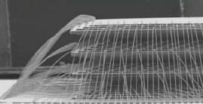
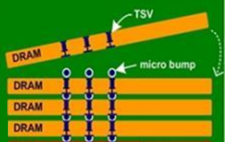
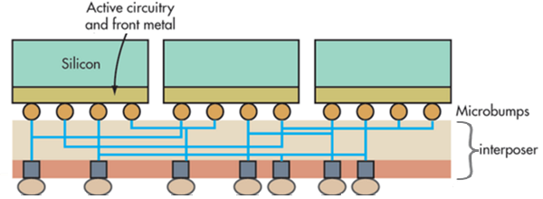
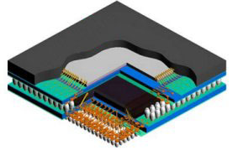
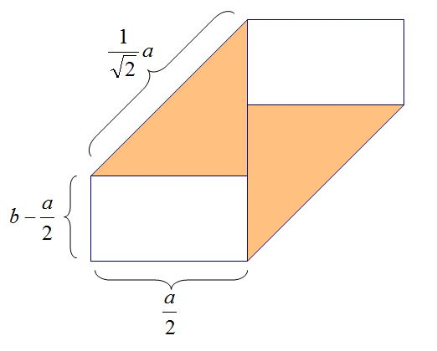
SOFM (Small Outline Folded Module: Origami Module)
@ Embedded System iKohza
Embedded Systems require 1) small size, 2) low power consumption, 3) high data bandwidth, and 4) lighter weight, among many other design parameters. Although a 3-dimensional chip stacking structure provides a solution for these 4 requirements, previous technologies suffer from: 1) high production cost, 2) low productivity, and 3) inflexibility to integrate exotic chips.
Basic idea is: 1) utilize a flexible/ foldable printed circuit board as an interposer to provide interconnection among IC chips, 2) fold the flexible PCBs in Origami (Japanese traditional paper folding art) style to take advantage of the flexibility and versatility of Origami method to minimize the total size of integration as well as optimizing the interconnection lengths.
Since this research is between chip design and packaging, there wait many challenging research opportunities, such as placement and routing, manufacturing process, material choice, testing, integration of heterogeneous devices, optimization of # of wiring layers and micro bump location, etc.
Wire bonding
TSVs
Flexible PCB
Prototype Origami CSP
MCP
2.5D
Origami
Novel Structure !
No more of these !

